Slide 1
2019
DHIC&SRTC
Program

Slide 2
ABOUT SHANGHAI
China is the second largest country in the world GDP. Shanghai is the first largest city in the China GDP. Meanwhile, Shanghai is also the largest Chinese city by population and the largest city proper by population in the world.
MODERN

Slide 3
ABOUT SHANGHAI
HOW BIG ?
Shanghai Area： 6340 Square kilometers
Madrid Area： 607 Square kilometers
Paris Area ： 105.4 Square kilometers
New York Area: 789 Square kilometers
MEANS
Shanghai= 10.5 x Madrid
Shanghai= 60 x Paris
Shanghai= 8 x New York

Slide 4
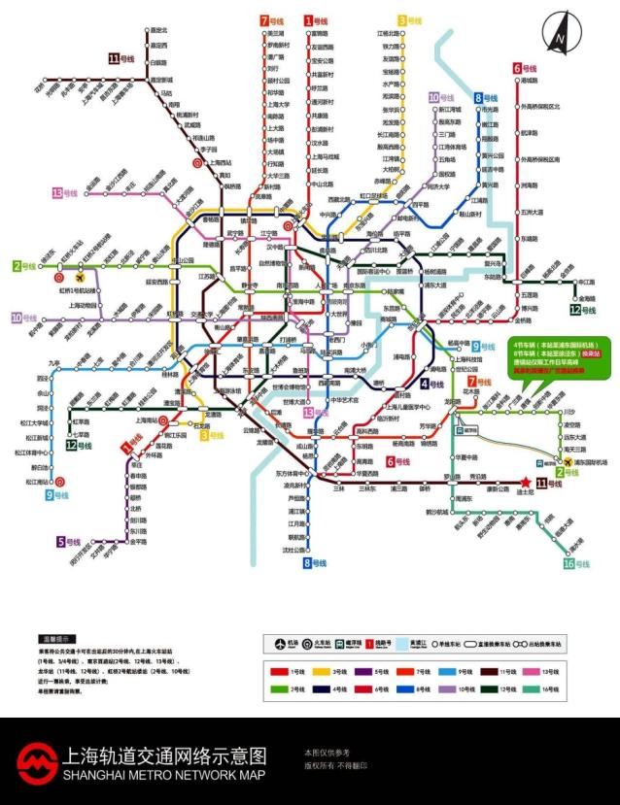
Shanghai Metro Network
The total length of Shanghai underground is 617 KM and the operating mileage is ranked No.1 in the world.
In 2016, more than 3.5 billion passengers are using the networks, ranked world No.2.
In 2020, the total length of Shanghai underground will be more than 800KM.
You can reach everywhere in Shanghai by underground.

Slide 5
SHANGHAI UNIVERSITY
Shanghai University is one of the major universities in Shanghai directly under the jurisdiction of the Municipal Government and one of the 100 key institutions of higher learning the Chinese Central Government gives full support in the 21st century. Founded in October 1922, Shanghai University has developed into a comprehensive university with a variety of disciplines including sciences, engineering, liberal arts, history, law, fine arts, business, economics and management. Shanghai University has 28 schools and 2 independent departments, with 68 undergraduate programs, 131 master programs, 17 engineering master programs, 35 Ph.D. programs, 13 post-doctoral programs and 1 MBA program. There are currently more than 2700 full-time faculty members and 43000 students.
KNOW MORE

Slide 6
ABOUT RUIYA
Ruiya Consulting Group is the leading consulting group of providing oversea study and internship in China. As the official partner of Shanghai University, Ruiya provides professional consulting service for students doing internship in hospitality industry. The internship base has covered over 10 top hotel brands including Disney, Marriot, IHG, ACCOR, SHANGRI-LA, Hyatt, Kempinski, Hilton, Fairmont, BANYAN TREE, DongHu, JinJiang and etc.

Slide 7
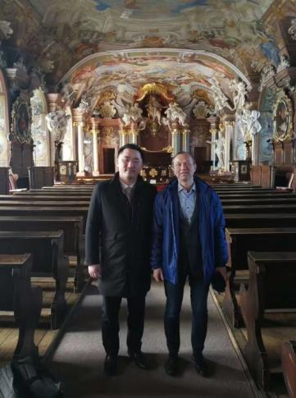
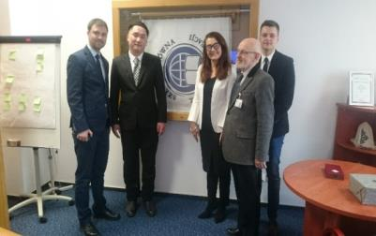
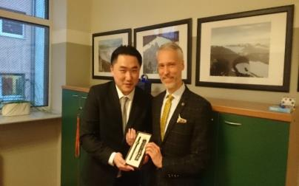
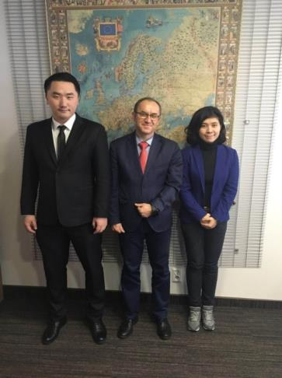
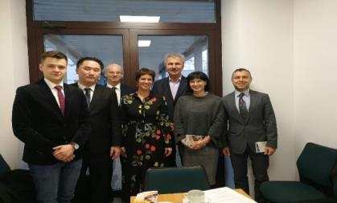
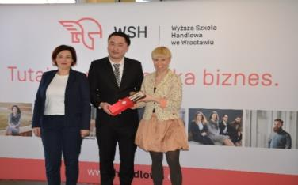
Our Partners in Poland
DHIC Program has become the most famous credit and internship program in Europe. DHIC Program has cooperation with many partners in Poland, including Warsaw, Wroclaw, Krakow, Gdansk, Poznan, Katowice and etc.
Szkoła Główna Turystyki i Rekreacji w Warszawie
Wyższa Szkoła Bankowa w Poznaniu
Wyższa Szkoła Handlowa we Wrocławiu
Akademia Wychowania Fizycznego w Krakowie
Akademia Wychowania Fizycznego w Katowicach
Uniwersytet Wrocławski

Slide 8
ALL ABOUT
THE DHIC PROGRAM
Courses
Internship
Duration: 13 weeks
Choices: 8 optional courses
Language: English
Duration: 6 Months
Work Meals: Free
Accommodations: Free/House Pension
Allowance: About 325~625Euro/Month
Timetable | Registration and Orientation | Study in SHU | Internship
Autumn Session-2019 | Sep 5, 2019 | Sep 9-Dec 6, 2019 | Jan 10-Jul 11, 2020
Spring Session-2020 | Mar 17, 2020 | Mar 18-Jun 14, 2020 | Jul 10-Jan 11, 2021

Slide 9
COURSES
Course Description
Chinese Language: Beginning Level
Tourism Management-Principles and Practices of Tourism in China
Communication Skill
Hospitality Market Strategy in China
Asian Economic
Chinese Tourism Industry
Chinese Culture
Hospitality Management Studies
PICKING MAXIMUM 5 COURSES & MINIMUM 3 COURSES

Slide 10
INTERNSHIP
6 MONTHS INTERNSHIP – Offering Front Office, Food and Beverage, Event Management, Guest Relations, Kitchen and etc.

Slide 11
INTERCONTINENTAL SHANGHAI EXPO
THREE ON THE BUND
OUR HOTELS
LE MERIDIEN SHANGHAI MINHANG
JW MARRIOTT SHANGHAI TOMORROW SQUARE

Slide 12
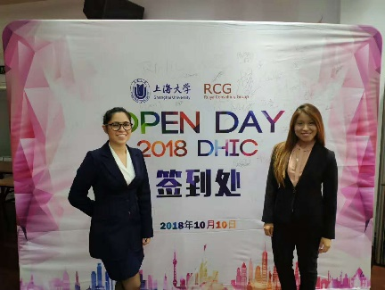
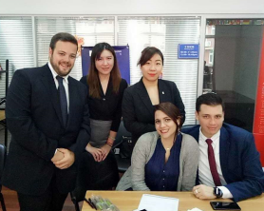
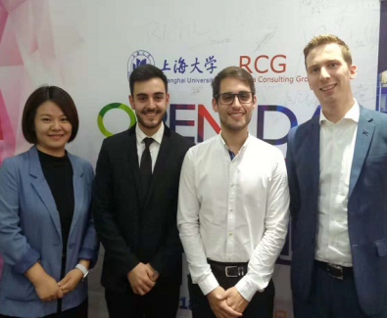
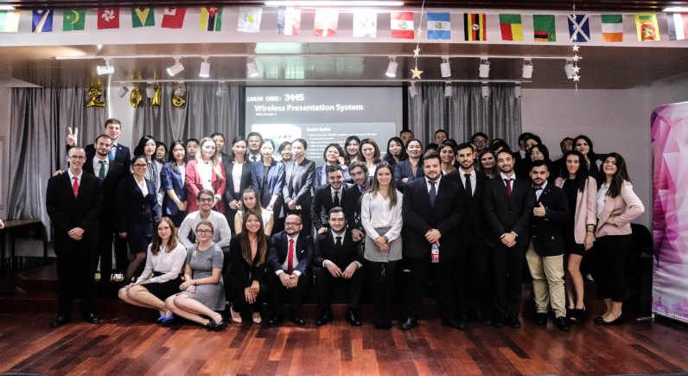
OPEN DAY
All the internship company will come on Open Day. They will provide campus talk and interviews for DHIC students. Students could apply for three choices maximum and confirm the interview status after Open Day.
If particular students are offered more than one choice, students can only choose one of them. If particular students fail all interviews, Ruiya will recommend special offer for students and they must follow this offer.
Watch the Video about Open Day

Slide 13
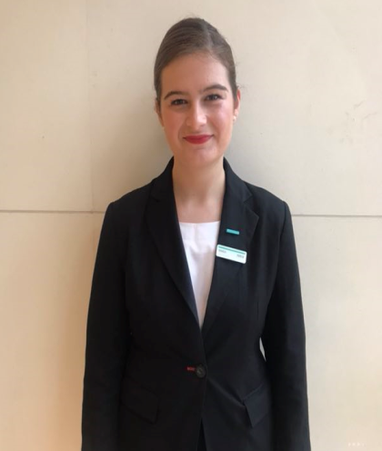
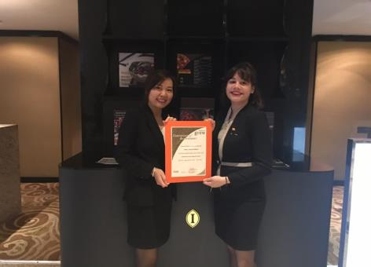
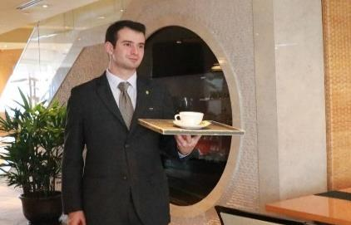
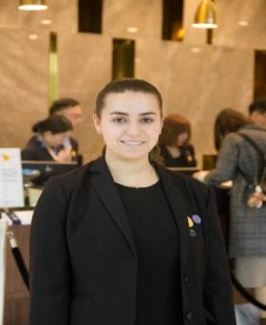
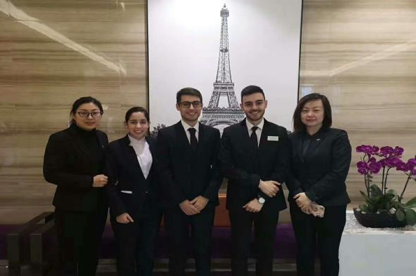
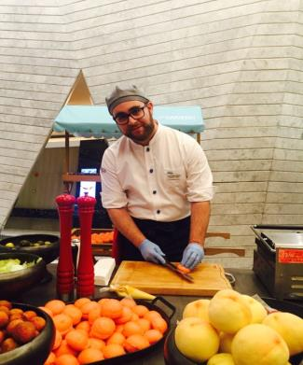
María
Le Royal Meridien
María
IHG Pudong
Ramón
IHG EXPO
Diana
HQ Novotel
TOP PLATFORM FOR TOP CAREER
Anna & Agnieszka
Global Harbor Hyatt
Melchor & Alberto
Huazhu Group
Agustín
Le Meridien Minhang

Slide 14
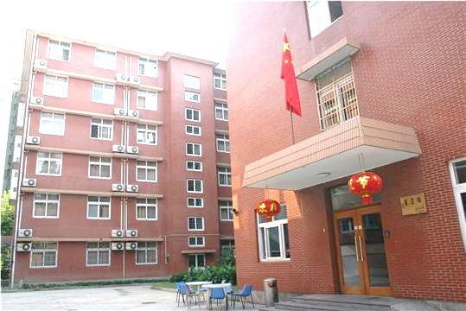
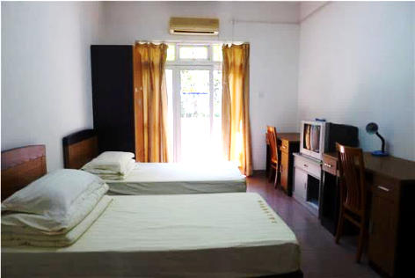
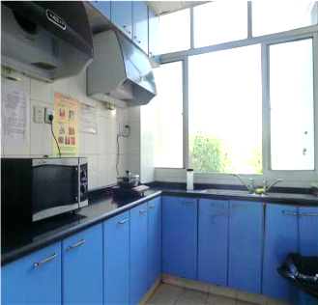
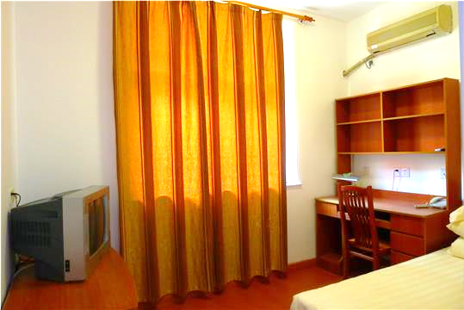
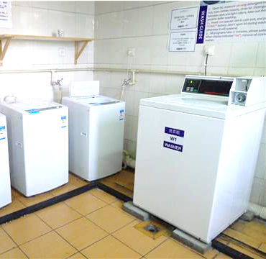
ON-CAMPUS DORMITORY
BED | ✔
DESK | ✔
CLOSET | ✔
AIR-CONDITIONER | ✔
BATHROOM | ✔
SHARED KITCHEN | ✔
WASHING MACHINE | ✔
Price
On-Campus | RMB/Night | RMB/Month | EURO/Month
DOUBLE ROOM | 75 | 2250 | About 290
SINGLE ROOM | 150 | 4500 | About 580
Only necessary in Stage 1(3~4 months study in SHU).
In Stage 2(6 months internship), Internship company will provide free accommodation or house pension.

Slide 15
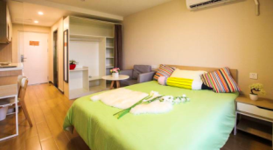
OFF-CAMPUS RESIDENCE
Ruiya Consulting Group is providing service for off-campus residence. You will check the room situation by your own when you arrive in Shanghai. The usual payment is one-month rental with one-month deposit. Depending on the size, location and decoration quality, the price is different.
Price
2200~4500RMB/Month/Person
(About 285~580EURO/Month/Person)
Only necessary in Stage 1(3~4 months study in SHU).
In Stage 2(6 months internship), Internship company will provide free accommodation or house pension.

Slide 16
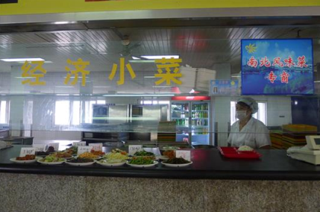
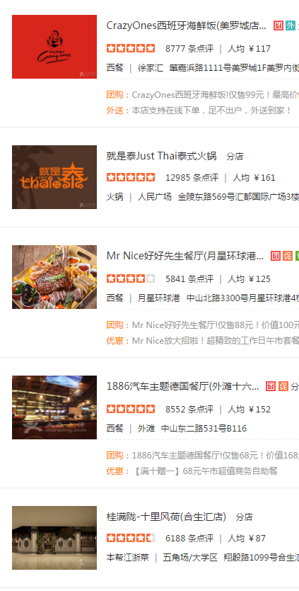
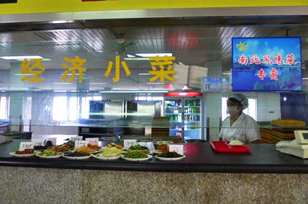
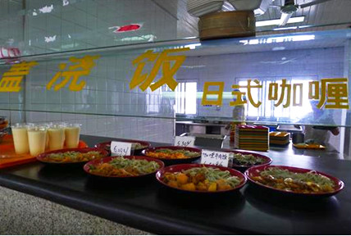
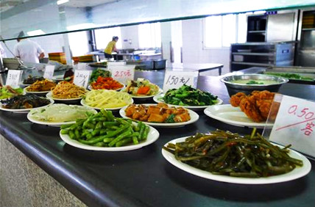
2~3 Euro For Each Meals in Canteen in Shanghai University.
Various Choices of Cuisine in Restaurant or Shopping Center Covering Eastern & Western Cuisine.
Usually Each Meals in Restaurant will be 5~10 Euro.

Slide 17
PROGRAM FEE OF DHIC
Program Fees: 17,300RMB(About2,250€):
8 Optional English Taught Courses(Maximum 5/Minimum 3)
6 month Internship Arrangement
1 year International Insurance
2 Day Field Trip to Suzhou & Hangzhou
Certificate of Internship from Top Hotel Group
Related Company Visit & Lectures or Seminars
Estimation of allowance for 6 month internship: About 1,950~3,750 €
*DHIC is designed in non-cost model as the total allowance is enough to cover the program fees.

Slide 18
Silk Road to China
Exploration of Hospitality Industry and Chinese Culture
July 21-27, 2019

Slide 19
Silk Road to China
This program is jointly hosted by Ruiya Consulting Group and Shanghai University. The purpose of this program is to provides a platform for students and teachers to understand the current development of Chinese tourism and hotel industry as well as feel the charm of Chinese culture.
Shanghai is the host city for this program. As one of the top metropolis in the world, Shanghai is the window of China. In 2018, China International Import Expo is successful hold in Shanghai.
Students and teacher will have chance to visit this charming city and explore the worldwide tourist attraction including the Bund, Lujiazui, Xintiandi, Yu Garden and etc.
Silk Road to China is a non-profit program. Ruiya Consulting Group will sponsor the course fees and activity fees. Students will only pay the cost of public transportation and accommodations.
You can watch the video of Shanghai:
https://m.youtube.com/watch?v=OdN5lXgjQnA

Slide 20
About Agenda
July 21-27, 2019
Timetable | Monday | Tuesday | Wednesday | Thursday | Friday
 | July 22 | July 23 | July 24 | July 25 | July 26
Morning | Open Ceremony | Visit InterContinental Hotels | Visit Shanghai Museum | Visit Accor Hotels | Visit Marriott Hotels
Afternoon | SHU Visit | Visit Lujiazui | Visit Greenland Hotels | Visit the Bund | Visit Yu Garden

Slide 21
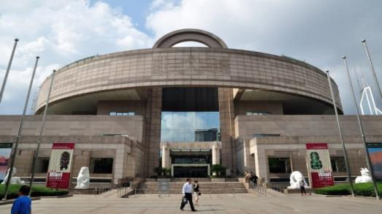
Lujiazui
Yu Garden
Shanghai Museum
The Bund

Slide 22
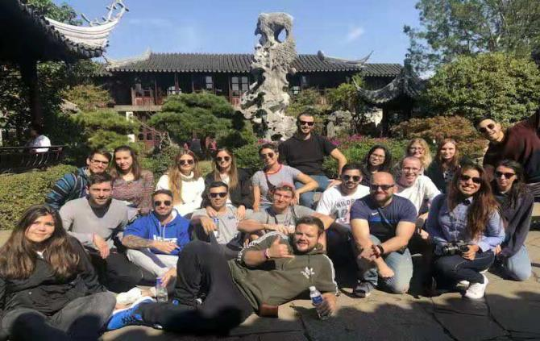
Program Fees: 500€
Silk Road to China is a non-profit program. The above fees is only for the cost of necessary public transportation and accommodation. All the costs of lectures and activities will be sponsored by Ruiya Consulting Group.
Other Potential Cost:
Round-trip Ticket(Poland-Shanghai): 500€~650€
Meals in Shanghai: 3€~5€ Per Meal
China Visa Fees: 40~60€
Application Requirement:
Registered Students of Partner University
Major Related to Tourism, Hotel, Kitchen, Event Management, International Relation Will Be An Advantage
Pass the Skype Interview of Ruiya Consulting Group

Slide 23
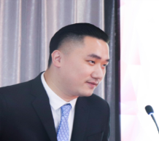
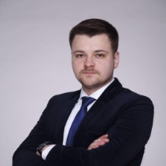
Program Contact
Director: Jacky Li
Email: jackyli@ifacecareer.com
Program Manager: Maciej Przeniczy
Phone/Whatsapp: +86 156 1864 6721
Email: maciej@ifacecareer.com
Facebook homepage: Kariera w hotelarstwie

Slide 24
Thanks

